Slide 1
Optimal Fixed Priority Scheduling with Deferred Pre-emption
Aditya Saripalli
(20173071)

Slide 2
Introduction
A common misconception with the Fixed Priority Scheduling of sporadic tasks (on a single processor) is that a “A fully pre-emptive scheduling” is the best approach for schedulability.
Fixed Priority scheduling is broadly classified into 3 categories
FPPS : Fixed Priority Pre-emptive Scheduling
FPNS : Fixed Priority Non-pre-emptive Scheduling
FPDS : Fixed Priority Scheduling with Deferred Pre-emption
FPPS and FPNS are incomparable, because the tasksets that are schedulable under FPPS may not be schedulable under FPNS and vice-versa
FPDS scheduling refer to a variety of different techniques by which pre-emptions may be deferred for some period after a high priority task becomes ready.

Slide 3
Introduction
FPDS is superior algorithm to FPPS and FPNS and therefore can schedule any taskset that is schedulable under FPPS and FPNS.
This paper analyse a form of FPDS where each task has a final non pre-emptive region.
There are 2 key parameters with FPDS
The priority assigned to each task
The length of each task’s final non pre-emptive region
This paper introduces and optimal algorithm (FNR-PA) for FPDS. It relies on finding the minimum final non pre-emptive region length for each task that ensures its schedulability.
FNR-PA : Final Non-pre-emptive region and Priority Assignment

Slide 4
History
Two different models of fixed priority scheduling with deferred pre-emption have been developed in the literature
Fixed Model
The location of each non-pre-emptive region is statically determined prior to execution.
Pre-emption is only permitted at pre-defined locations in the code for each task – ‘Pre-emption Points’.
Also know as co-operative scheduling.
Floating Model
An upper bound is set for the longest non-pre-emptive region of each task.
The location of each non-pre-emptive may vary at run-time.
In 2011, Bertogna derived a method of computing the optimal length of the final non-pre-emptive region of each task in order to maximize schedulability under FPDS for a given priority assignment

Slide 5
Assumptions
A discrete time model is assumed, where all task parameters are assumed to be positive integers.
Due to the integer time model considered in this paper, the discrete time granularity is “1” time unit.
The minimum possible length of a non-pre-emptive region is “1” rather than 0, as we assume a discrete time model and tasks cannot be pre-empted during a processor clock cycle.
The arrival times of the tasks are independent and unknown a-priori. Hence the tasks may share a common release time.
Each task is released (becomes ready to execute), as soon as it arrives. The tasks do not voluntarily suspend themselves.
Any resource access occurring within the final non-pre-emptive region of a task is properly nested, i.e. wholly included within that region, avoiding deadlocks.

Slide 6
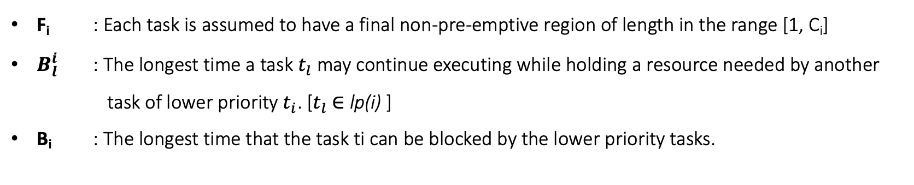
System Model, Terminology & Notation
"i" denotes priority (t₁ highest ... t_{n} lowest).
lp(i) : Set of tasks with priorities < "i"
lep(i) : Set of tasks with priorities ≤ "i"
hp(i) : Set of tasks with priorities > "i"
hep(i) : Set of tasks with priorities ≥ "i"
C_{i} : Worst case execution time of task t_{i}
R_{i} : Worst case response time of task t_{i}
T_{i} : Task period
D_{i} : Relative Deadline
U_{i} : Utilisation of task "t_{i}" is (C_{i} / T_{i})
F_{i} : Each task is assumed to have a final non-pre-emptive region of length in the range [1, C_{i}]
$B_{l}^{i}$ : The longest time a task $t_{l}$ may continue executing while holding a resource needed by another task of lower priority $t_{i}$. [$t_{l}$ $∈$ lp(i) ]
B_{i} : The longest time that the task ti can be blocked by the lower priority tasks.

Slide 7
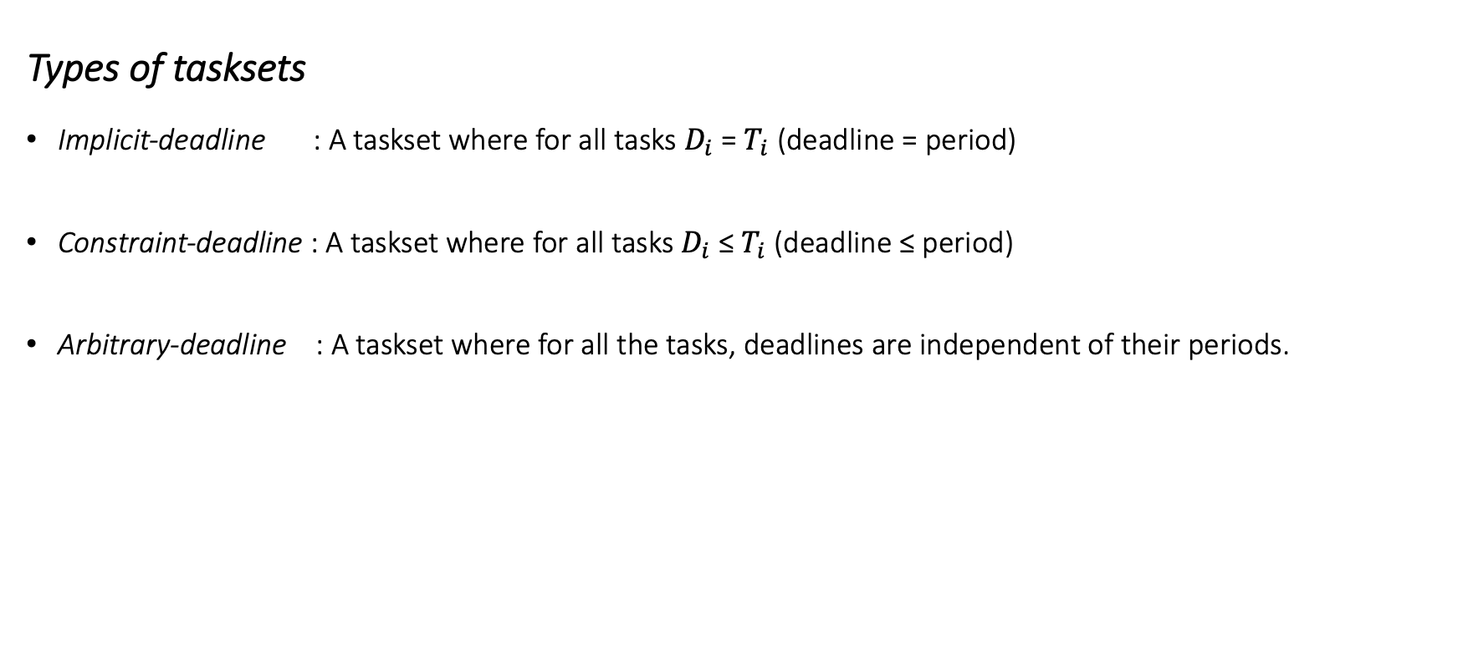
System Model, Terminology & Notation
Types of tasksets
Implicit-deadline : A taskset where for all tasks $D_{i}$ = $T_{i}$ (deadline = period)
Constraint-deadline : A taskset where for all tasks $D_{i}$ ≤ $T_{i}$ (deadline ≤ period)
Arbitrary-deadline : A taskset where for all the tasks, deadlines are independent of their periods.

Slide 8
Definitions
Schedulability: A taskset is said to be schedulable with respect to some scheduling algorithm, if all valid sequences of jobs that may be generated by the taskset can be scheduled by the algorithm without any missed deadlines.
Optimality: A priority assignment policy “P” is said to be optimal with respect to some class of tasksets and some type of fixed priority scheduling algorithm - if there are no tasksets in the class that are schedulable under the scheduling algorithm using any other priority ordering policy, that are not also schedulable using the priority assignment determined by policy “P”.
A fixed priority scheduling algorithm A is said to dominate another fixed priority scheduling algorithm B if there are tasksets that can be scheduled under algorithm A, but cannot be scheduled under algorithm B, and all of the tasksets that are schedulable under algorithm B are also schedulable under algorithm A.
If there are tasksets that are schedulable under algorithm A, but not under algorithm B, and vice-versa, then the two algorithms are said to be incomparable.
If both algorithms can schedule precisely the same tasksets then they are said to be equivalent.

Slide 9
Definitions
Sustainability of a Scheduling Algorithm: A scheduling algorithm is said to be sustainable with respect to a system model, if and only if schedulability of any taskset compliant with the model implies schedulability of the same taskset modified by:
Decreasing execution times
Increasing periods or inter-arrival times, and
Increasing deadlines
Sustainability of a Schedulabiltiy Test: A schedulability test is referred to as sustainable if the above changes {1, 2, 3} cannot result in a taskset that was previously deemed schedulable by the test becoming un-schedulable.

Slide 10
Summarizing Prior Work
Priority level-i active period : A continuous period [t1,t2) during which tasks, of priority "i" or higher, that were released at the start of the active period at t₁ , or during the active period but strictly before its end at t₂ , are either executing or ready to execute.
∆-Critical Instance (for a task t_{i} ) : Occurs when t_{i} is released simultaneously with all higher priority tasks, and subsequent releases of task t_{i} and higher priority tasks occur after the minimum permitted time intervals.
Further a minimum possible amount of time ∆ prior to this simultaneous release, a lower priority task t_{k} enters its final non-pre-emptive region or begins accessing a resource shared with a task of priority "i" or higher.
Previous work on FPDS established that, the longest response time of a task t_{i} occurs for some job of that task within the priority level-i active period starting at ∆-Critical Instant.

Slide 11
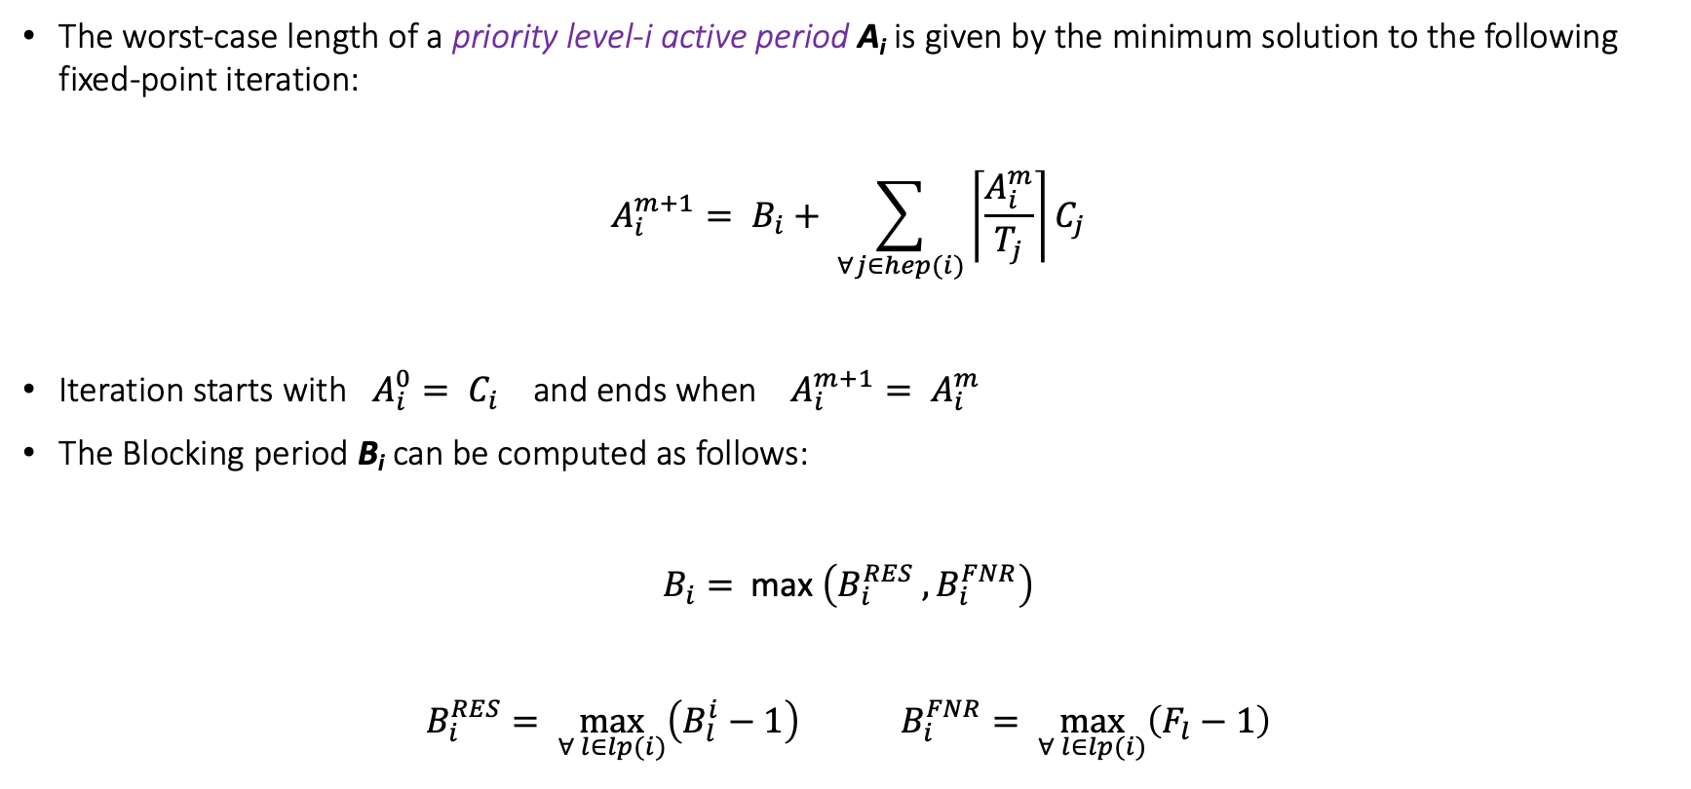
Summarizing Prior Work
The worst-case length of a priority level-i active period A_{i} is given by the minimum solution to the following fixed-point iteration:
$$A_{i}^{m+1}= B_{i}+ \sum_{∀j∈hep(i)}{\left\lceil \frac{A_{i}^{m}}{T_{j}}\right\rceil C_{j}}$$
Iteration starts with $A_{i}^{0}= C_{i}$ and ends when $A_{i}^{m+1}= A_{i}^{m}$
The Blocking period B_{i} can be computed as follows:
$B_{i}=$ max $\left(B_{i}^{RES} , B_{i}^{FNR}\right)$
$B_{i}^{RES}= \max_{∀ l∈lp(i)}\left(B_{l}^{i}−1\right)$ $B_{i}^{FNR}= \max_{∀ l∈lp(i)}\left(F_{l}−1\right)$
(1)
(2)

Slide 12
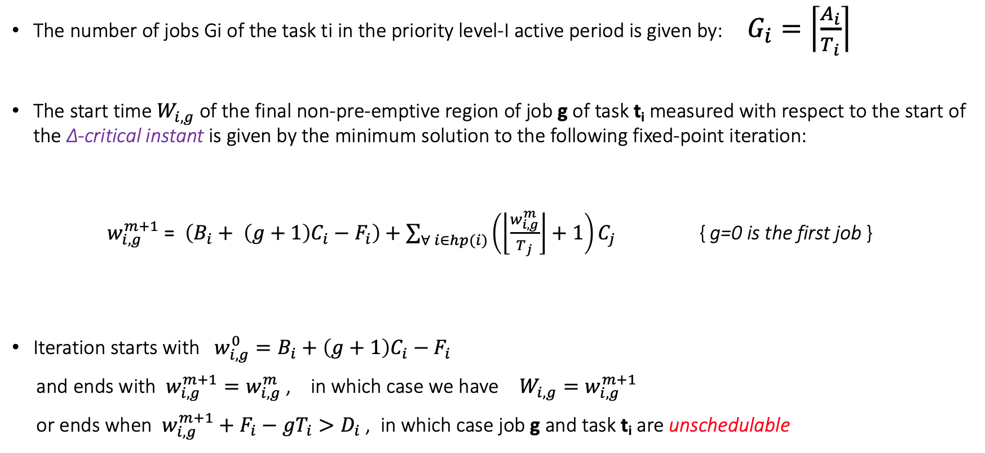
Summarizing Prior Work
The number of jobs Gi of the task ti in the priority level-I active period is given by: $G_{i}=\left\lceil \frac{A_{i}}{T_{i}}\right\rceil$
The start time $W_{i,g}$ of the final non-pre-emptive region of job g of task t_{i} measured with respect to the start of the ∆-critical instant is given by the minimum solution to the following fixed-point iteration:
$w_{i,g}^{m+1}\text{ = }\left(B_{i}+ \left(g+1\right)C_{i}−F_{i}\right)+\sum_{∀ i∈hp(i)}{\left(\left\lfloor \frac{w_{i,g}^{m}}{T_{j}}\right\rfloor +1\right)}C_{j}$ { g=0 is the first job }
Iteration starts with $w_{i,g}^{0}=B_{i}+\left(g+1\right)C_{i}−F_{i}$
and ends with $w_{i,g}^{m+1}=w_{i,g}^{m}$ , in which case we have $W_{i,g}=w_{i,g}^{m+1}$
or ends when $w_{i,g}^{m+1}+F_{i}−gT_{i}>D_{i}$ , in which case job g and task t_{i} are unschedulable
(3)

Slide 13
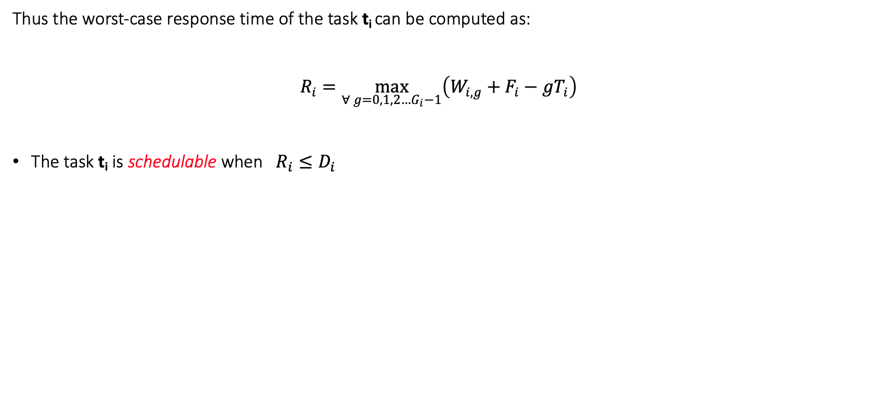
Summarizing Prior Work
Thus the worst-case response time of the task t_{i} can be computed as:
$R_{i}=\max_{∀ g=0,1,2…G_{i}−1}\left(W_{i,g}+F_{i}−gT_{i}\right)$
The task t_{i} is schedulable when $R_{i}≤D_{i}$

Slide 14
Problem Descriptions
Problem-1
Final Non-pre-emptive Region length (FNR) Problem
For a given taskset complying with the task model described above and a given priority ordering X, find a value for the length of the final non-pre-emptive region of each task such that the taskset is schedulable under FPDS.
Problem-2
Final Non-pre-emptive Region length & Priority Assignment (FNR-PA) Problem
For a given taskset complying with the task model described above, find both
A priority assignment, and
A value for the length of the final non-pre-emptive region of each task that makes the taskset schedulable under FPDS.

Slide 15
An Example
Let us consider an example to show the effectiveness of FPDS scheduling algorithm over other fixed-priority scheduling algorithms
Consider the following taskset:
We can see that Task tA should be given the highest priority, irrespective of whether we use FPPS or FPNS or FPDS.
Considering deadline monotonic scheduling we get the priority order as:
P_{A} > P_{B} > P_{C}
Task | Period | Execution Time | Deadline
t_{A} | 250 | 100 | 175
t_{B} | 400 | 100 | 300
t_{C} | 350 | 100 | 325

Slide 16
FPPS
D_{C} = 325
100
200
300
400
t_{A}
t_{B}
t_{C}
Deadline Miss

Slide 17
FPNS
D_{C} = 325
D_{C} = 650
100
200
300
400
500
600
700
800
t_{A}
t_{B}
t_{C}
Deadline Miss

Slide 18
FPNS
100
200
300
400
500
600
700
800
t_{A}
t_{C}
t_{B}
How about reversing the priorities P_{B} and P_{C} ---- it worked !!!
But how to decide which priority order is optimal ?

Slide 19
FPDS
100
200
300
400
500
600
700
800
t_{A}
t_{C}
t_{B}
Using FNR-PA we get:
The optimal priority order : PA > PC > PB
Final non-pre-emptive region lengths: FA = 1, FC = 1 & FB = 51

Slide 20
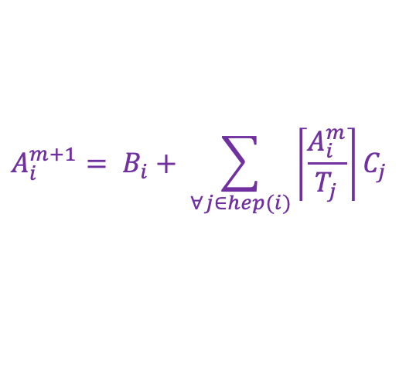
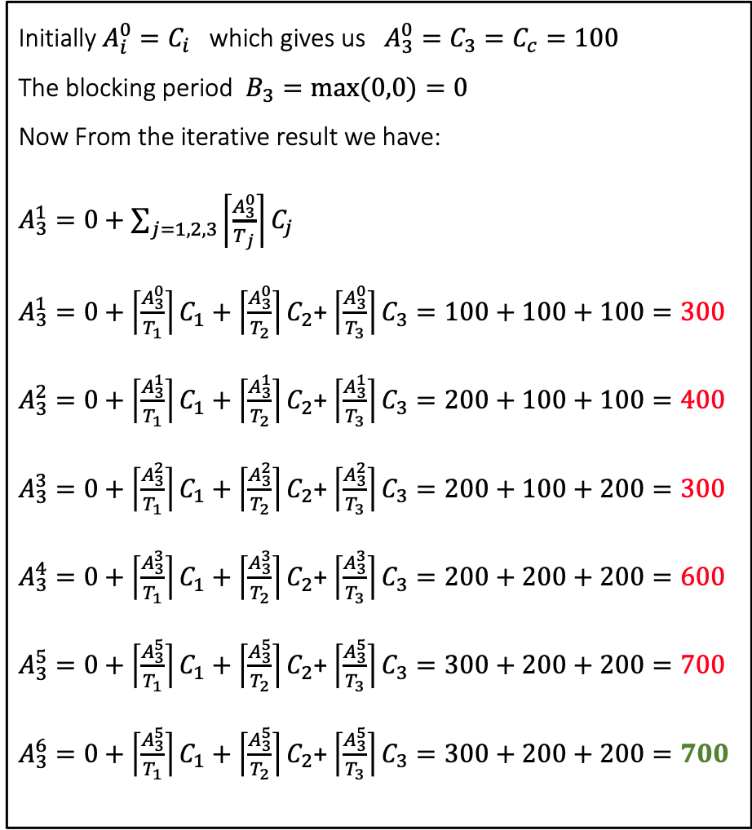
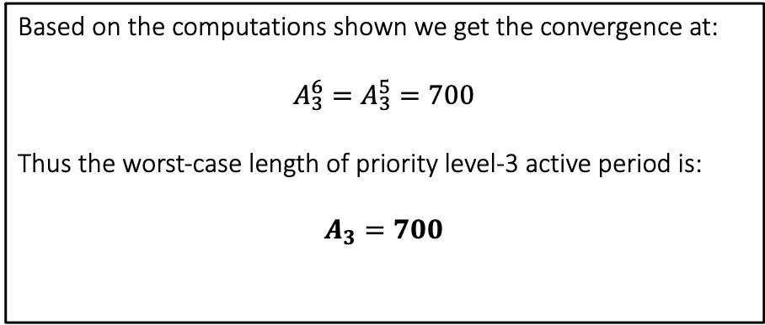
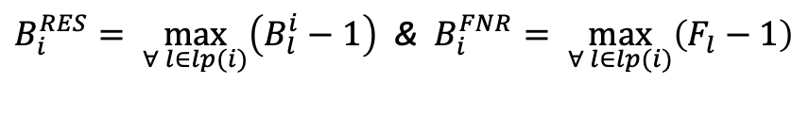
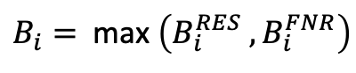
Mathematical Approach
Initially $A_{i}^{0}=C_{i}$ which gives us $A_{3}^{0}=C_{3}=C_{c}=100$
The blocking period $B_{3}=max⁡(0,0)=0$
Now From the iterative result we have:
$A_{3}^{1}=0+\sum_{j=1,2,3}{\left\lceil \frac{A_{3}^{0}}{T_{j}}\right\rceil C_{j}}$
$A_{3}^{1}=0+\left\lceil \frac{A_{3}^{0}}{T_{1}}\right\rceil C_{1}+\left\lceil \frac{A_{3}^{0}}{T_{2}}\right\rceil C_{2}$+ $\left\lceil \frac{A_{3}^{0}}{T_{3}}\right\rceil C_{3}=100+100+100=300$
$A_{3}^{2}=0+\left\lceil \frac{A_{3}^{1}}{T_{1}}\right\rceil C_{1}+\left\lceil \frac{A_{3}^{1}}{T_{2}}\right\rceil C_{2}$+ $\left\lceil \frac{A_{3}^{1}}{T_{3}}\right\rceil C_{3}=200+100+100=400$
$A_{3}^{3}=0+\left\lceil \frac{A_{3}^{2}}{T_{1}}\right\rceil C_{1}+\left\lceil \frac{A_{3}^{2}}{T_{2}}\right\rceil C_{2}$+ $\left\lceil \frac{A_{3}^{2}}{T_{3}}\right\rceil C_{3}=200+100+200=300$
$A_{3}^{4}=0+\left\lceil \frac{A_{3}^{3}}{T_{1}}\right\rceil C_{1}+\left\lceil \frac{A_{3}^{3}}{T_{2}}\right\rceil C_{2}$+ $\left\lceil \frac{A_{3}^{3}}{T_{3}}\right\rceil C_{3}=200+200+200=600$
$A_{3}^{5}=0+\left\lceil \frac{A_{3}^{5}}{T_{1}}\right\rceil C_{1}+\left\lceil \frac{A_{3}^{5}}{T_{2}}\right\rceil C_{2}$+ $\left\lceil \frac{A_{3}^{5}}{T_{3}}\right\rceil C_{3}=300+200+200=700$
$A_{3}^{6}=0+\left\lceil \frac{A_{3}^{5}}{T_{1}}\right\rceil C_{1}+\left\lceil \frac{A_{3}^{5}}{T_{2}}\right\rceil C_{2}$+ $\left\lceil \frac{A_{3}^{5}}{T_{3}}\right\rceil C_{3}=300+200+200=700$
$$A_{i}^{m+1}= B_{i}+ \sum_{∀j∈hep(i)}{\left\lceil \frac{A_{i}^{m}}{T_{j}}\right\rceil C_{j}}$$
$B_{i}=$ max $\left(B_{i}^{RES} , B_{i}^{FNR}\right)$
$B_{i}^{RES}= \max_{∀ l∈lp(i)}\left(B_{l}^{i}−1\right)$ & $B_{i}^{FNR}= \max_{∀ l∈lp(i)}\left(F_{l}−1\right)$
Based on the computations shown we get the convergence at:
$$A_{3}^{6}=A_{3}^{5}=700$$
Thus the worst-case length of priority level-3 active period is:
$$A_{3}=700$$

Slide 21
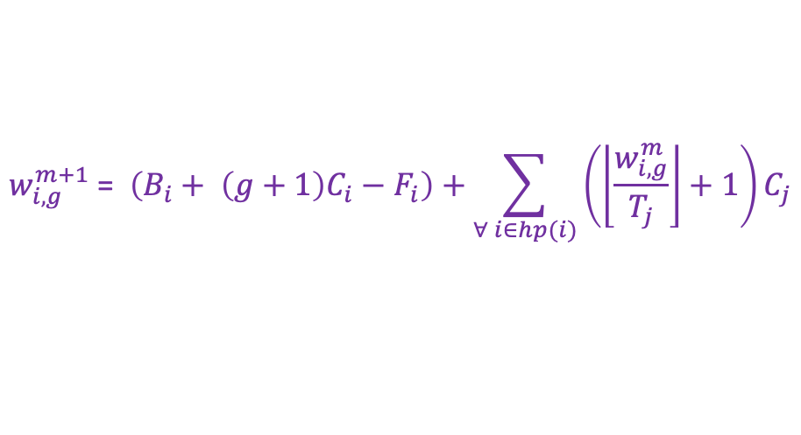
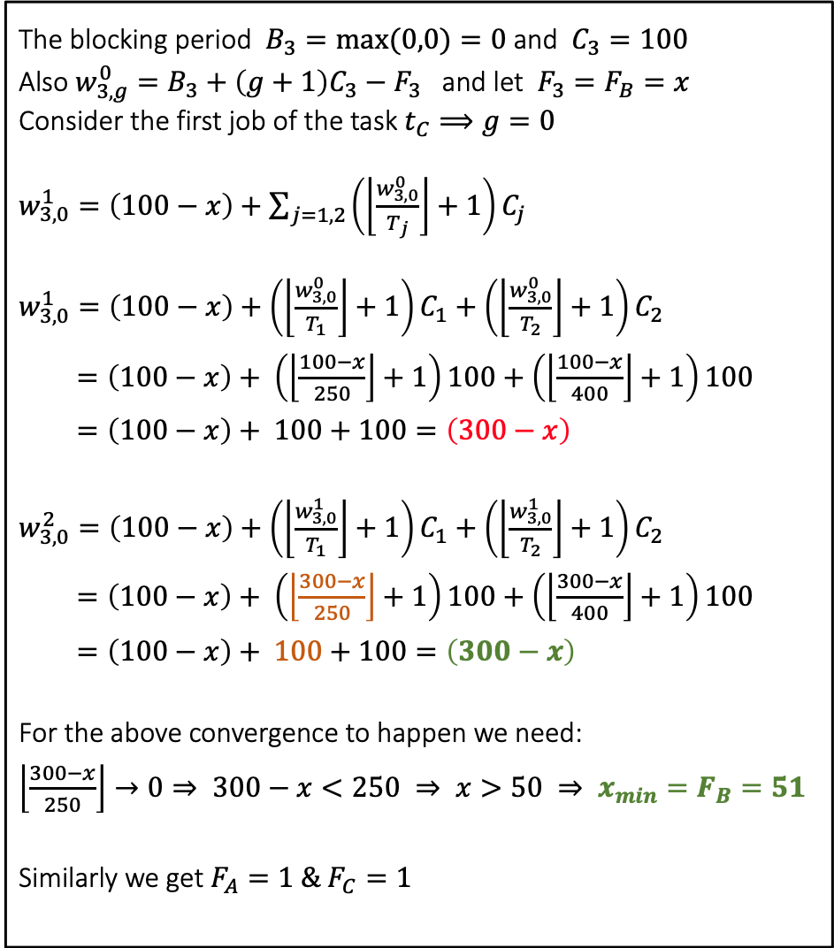
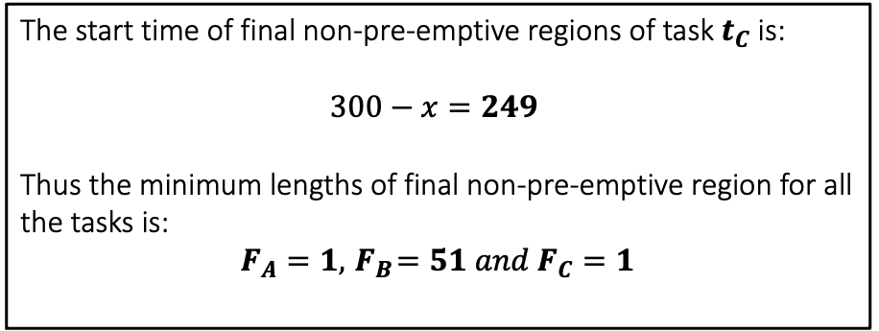
Mathematical Approach
The blocking period $B_{3}=max⁡(0,0)=0$ and $C_{3}=100$
Also $w_{3,g}^{0}=B_{3}+\left(g+1\right)C_{3}−F_{3}$ and let $F_{3}=F_{B}=x$
Consider the first job of the task $t_{C}⟹g=0$
$w_{3,0}^{1}=\left(100−x\right)+\sum_{j=1,2}{\left(\left\lfloor \frac{w_{3,0}^{0}}{T_{j}}\right\rfloor +1\right)C_{j}}$
$w_{3,0}^{1}=\left(100−x\right)+\left(\left\lfloor \frac{w_{3,0}^{0}}{T_{1}}\right\rfloor +1\right)C_{1}+\left(\left\lfloor \frac{w_{3,0}^{0}}{T_{2}}\right\rfloor +1\right)C_{2}$
$=\left(100−x\right)+ \left(\left\lfloor \frac{100−x}{250}\right\rfloor +1\right)100+\left(\left\lfloor \frac{100−x}{400}\right\rfloor +1\right)100$
$=\left(100−x\right)+ 100+100=\left(300−x\right)$
$w_{3,0}^{2}=\left(100−x\right)+\left(\left\lfloor \frac{w_{3,0}^{1}}{T_{1}}\right\rfloor +1\right)C_{1}+\left(\left\lfloor \frac{w_{3,0}^{1}}{T_{2}}\right\rfloor +1\right)C_{2}$
$=\left(100−x\right)+ \left(\left\lfloor \frac{300−x}{250}\right\rfloor +1\right)100+\left(\left\lfloor \frac{300−x}{400}\right\rfloor +1\right)100$
$=\left(100−x\right)+ 100+100=\left(300−x\right)$
For the above convergence to happen we need:
$\left\lfloor \frac{300−x}{250}\right\rfloor →0⇒ 300−x<250 ⇒ x>50 ⇒ {x_{min}=F}_{B}=51$
Similarly we get $F_{A}=1 \& F_{C}=1$
$$w_{i,g}^{m+1}\text{ = }\left(B_{i}+ \left(g+1\right)C_{i}−F_{i}\right)+\sum_{∀ i∈hp(i)}{\left(\left\lfloor \frac{w_{i,g}^{m}}{T_{j}}\right\rfloor +1\right)C_{j}}$$
$B_{i}=$ max $\left(B_{i}^{RES} , B_{i}^{FNR}\right)$
$B_{i}^{RES}= \max_{∀ l∈lp(i)}\left(B_{l}^{i}−1\right)$ & $B_{i}^{FNR}= \max_{∀ l∈lp(i)}\left(F_{l}−1\right)$
The start time of final non-pre-emptive regions of task $t_{C}$is:
$$300−x=249$$
Thus the minimum lengths of final non-pre-emptive region for all the tasks is:
$$F_{A}=1, { F}_{B}=51 and F_{C}=1$$

Slide 22
Algorithms
FNR
for each priority level k, lowest first { # determine the smallest value for the final non-pre-emptive region length F(k) such that the task at priority k is schedulable. # Set the length of the final non-pre- emptive region of the task to this value. }
FNR-PA
for each priority level k, lowest first { for each unassigned task { # determine the smallest value for the final non-pre-emptive region length F(k) such that task 't' is schedulable at priority k, assuming all other unassigned tasks have higher priorities. # record as task 'Z' the unassigned task with the minimum value for the length of its final non-pre-emptive region F(k). } if no tasks are schedulable at priority k { return unschedulable } else { # assign priority k to task 'Z’ # use the value of F(k) as the length of its final non–pre- emptive region. } } return schedulable

Slide 23
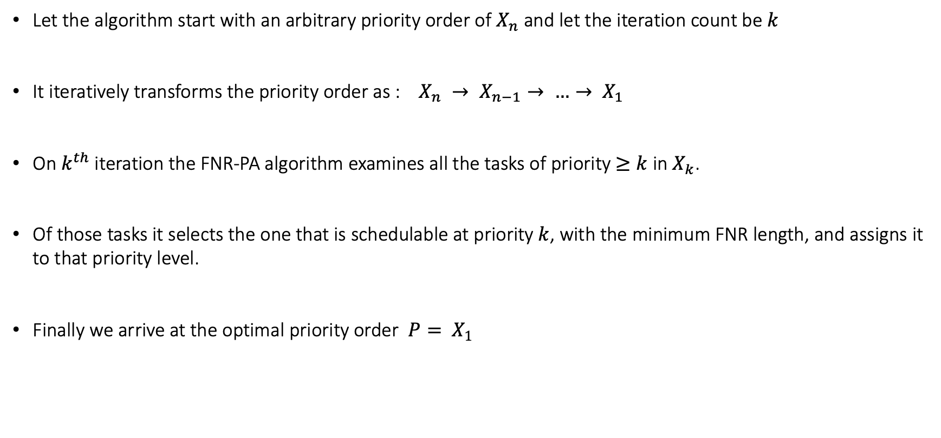
FNR-PA Outline
Let the algorithm start with an arbitrary priority order of $X_{n}$ and let the iteration count be $k$
It iteratively transforms the priority order as : $X_{n} → X_{n−1}→ …→ X_{1}$
On $k^{th}$ iteration the FNR-PA algorithm examines all the tasks of priority $≥k$ in $X_{k}$.
Of those tasks it selects the one that is schedulable at priority $k$, with the minimum FNR length, and assigns it to that priority level.
Finally we arrive at the optimal priority order $P= X_{1}$

Slide 24
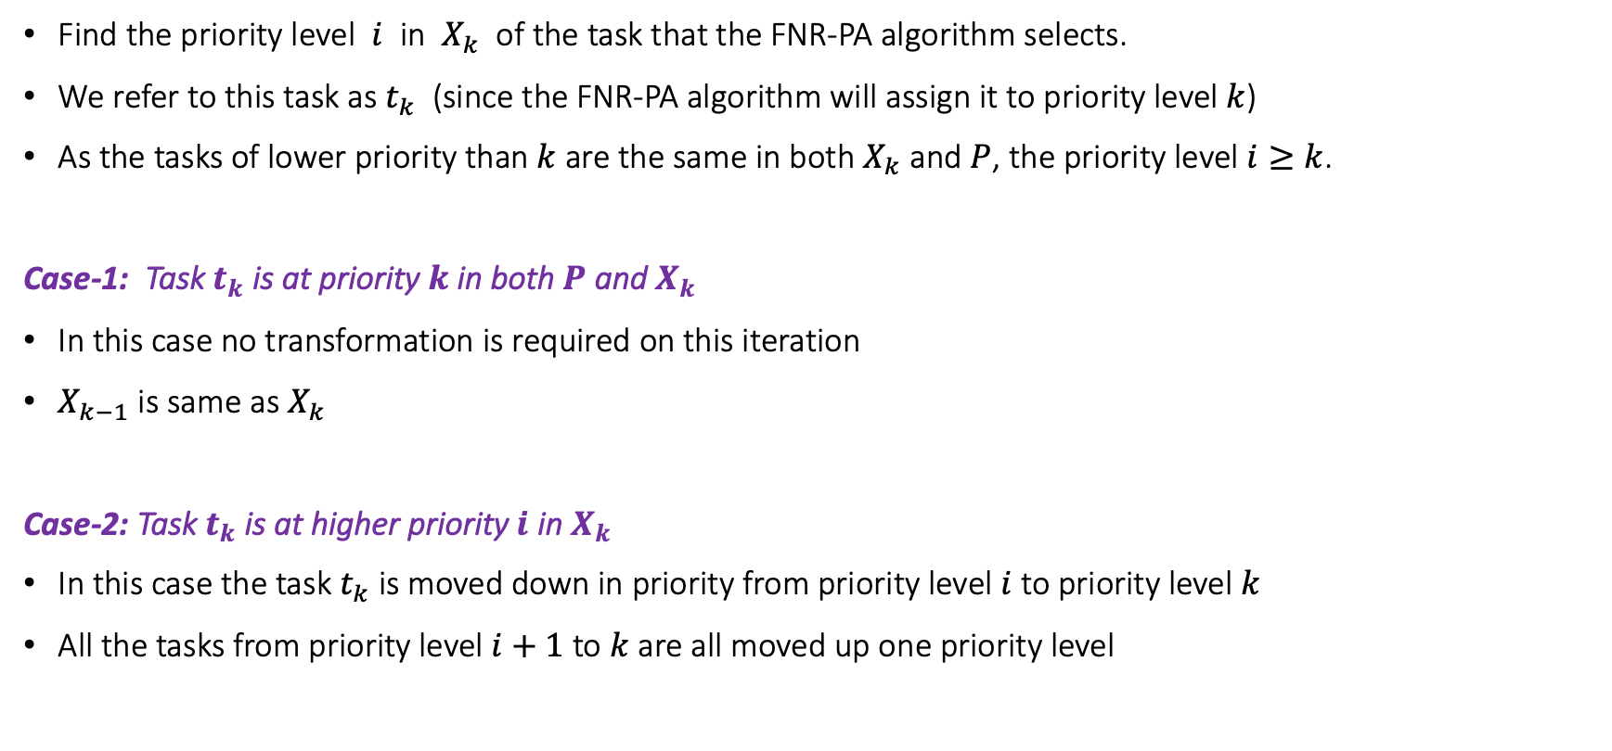
FNR-PA Transformation
Find the priority level $i$ in $X_{k}$ of the task that the FNR-PA algorithm selects.
We refer to this task as $t_{k}$ (since the FNR-PA algorithm will assign it to priority level $k$)
As the tasks of lower priority than $k$ are the same in both $X_{k}$ and $P$, the priority level $i≥k$.
Case-1: Task $t_{k}$ is at priority $k$ in both $P$ and $X_{k}$
In this case no transformation is required on this iteration
$X_{k−1}$ is same as $X_{k}$
Case-2: Task $t_{k}$ is at higher priority $i$ in $X_{k}$
In this case the task $t_{k}$ is moved down in priority from priority level $i$ to priority level $k$
All the tasks from priority level $i+1$ to $k$ are all moved up one priority level

Slide 25
FNR-PA Transformation
1
i
i +1
k
n
1
i
i +1
k
n
Optimal Priority Order P
X_{k}
X_{k-1}
Greedily building the Optimal Priority Order

Slide 26
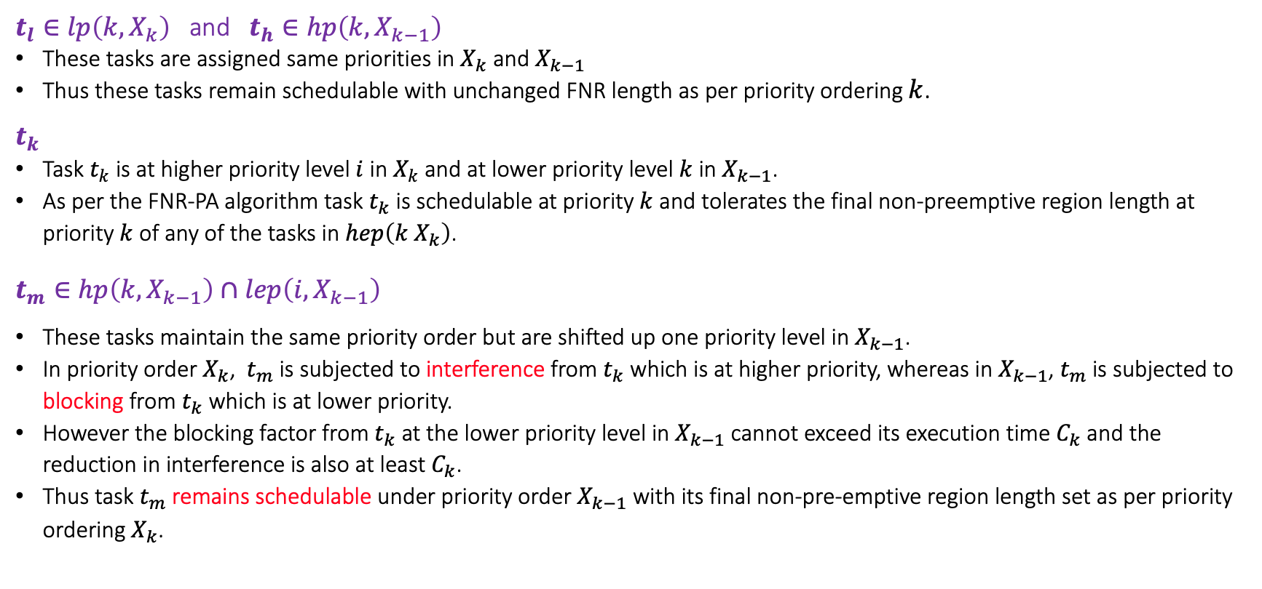
FNR-PA Transformation
$t_{l}∈lp\left(k,X_{k}\right)$ and $t_{h}∈hp\left(k,X_{k−1}\right)$
These tasks are assigned same priorities in $X_{k}$ and $X_{k−1}$
Thus these tasks remain schedulable with unchanged FNR length as per priority ordering $k$.
$t_{k}$
Task $t_{k}$ is at higher priority level $i$ in $X_{k}$ and at lower priority level $k$ in $X_{k−1}$.
As per the FNR-PA algorithm task $t_{k}$ is schedulable at priority $k$ and tolerates the final non-preemptive region length at priority $k$ of any of the tasks in $hep\left(k X_{k}\right)$.
$t_{m}∈hp\left(k,X_{k−1}\right)∩lep\left(i, X_{k−1}\right)$
These tasks maintain the same priority order but are shifted up one priority level in $X_{k−1}$.
In priority order $X_{k}$, $t_{m}$ is subjected to interference from $t_{k}$ which is at higher priority, whereas in $X_{k−1}$, $t_{m}$is subjected to blocking from $t_{k}$ which is at lower priority.
However the blocking factor from $t_{k}$ at the lower priority level in $X_{k−1}$ cannot exceed its execution time $C_{k}$ and the reduction in interference is also at least $C_{k}$.
Thus task $t_{m}$remains schedulable under priority order $X_{k−1}$ with its final non-pre-emptive region length set as per priority ordering $X_{k}$.

Slide 27
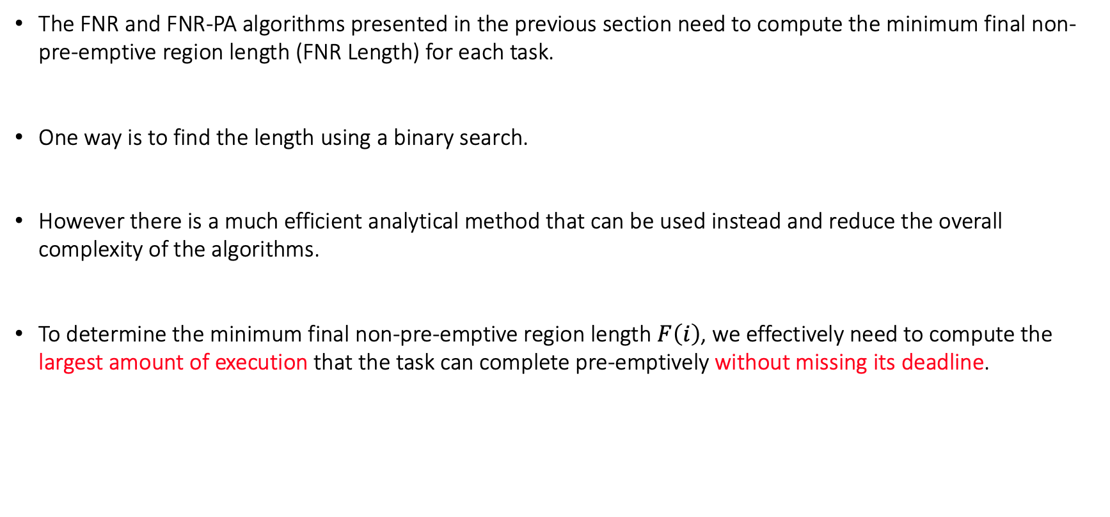
FNR Length Calculation
The FNR and FNR-PA algorithms presented in the previous section need to compute the minimum final non-pre-emptive region length (FNR Length) for each task.
One way is to find the length using a binary search.
However there is a much efficient analytical method that can be used instead and reduce the overall complexity of the algorithms.
To determine the minimum final non-pre-emptive region length $F\left(i\right)$, we effectively need to compute the largest amount of execution that the task can complete pre-emptively without missing its deadline.

Slide 28
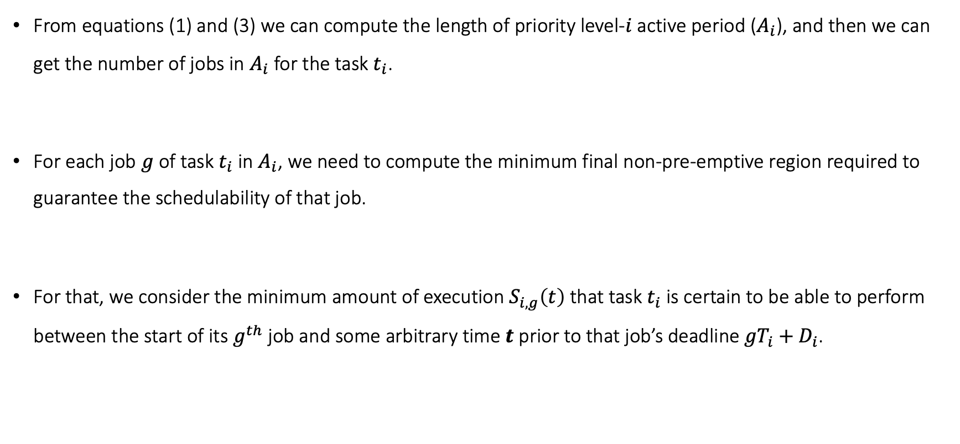
FNR Length Calculation
From equations (1) and (3) we can compute the length of priority level-$i$ active period ($A_{i}$), and then we can get the number of jobs in $A_{i}$ for the task $t_{i}$.
For each job $g$ of task $t_{i}$in $A_{i}$, we need to compute the minimum final non-pre-emptive region required to guarantee the schedulability of that job.
For that, we consider the minimum amount of execution $S_{i,g}\left(t\right)$ that task $t_{i}$is certain to be able to perform between the start of its $g^{th}$ job and some arbitrary time $t$ prior to that job’s deadline ${gT}_{i}+D_{i}$.

Slide 29
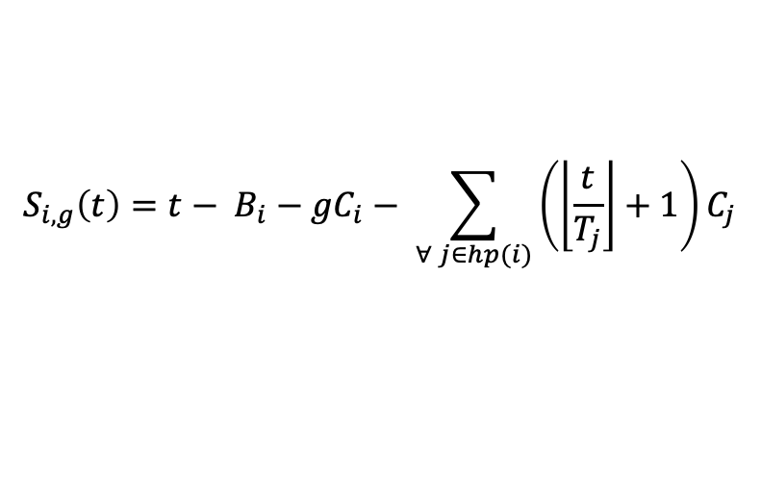
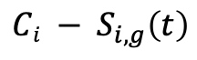
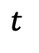
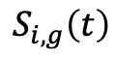
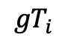
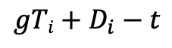
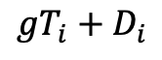
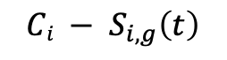
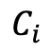
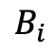
$$C_{i}$$
. . .
$$B_{i}$$
$$S_{i,g}\left(t\right)$$
$${Ci − S}_{i,g}\left(t\right)$$
$${gT}_{i}$$
$$t_{ }$$
$${gT}_{i}+D_{i}$$
Remaining
Execution Time:
$${Ci − S}_{i,g}\left(t\right)$$
$$S_{i,g}\left(t\right)=t− B_{i}−{gC}_{i}− \sum_{∀ j∈hp(i)}{\left(\left\lfloor \frac{t}{T_{j}}\right\rfloor +1\right)C_{j}}$$
Time to reach
Deadline:
$$gTi+D_{i}−t$$

Slide 30
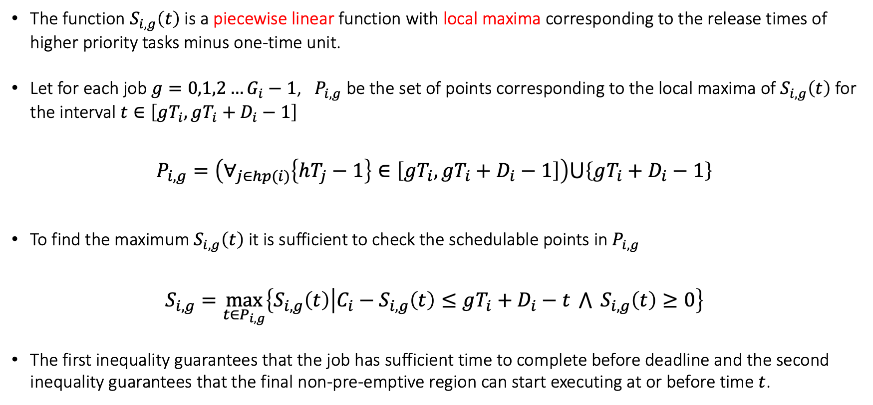
FNR Length Calculation
The function $S_{i,g}\left(t\right)$ is a piecewise linear function with local maxima corresponding to the release times of higher priority tasks minus one-time unit.
Let for each job $g=0,1,2…G_{i}−1$, $P_{i,g}$ be the set of points corresponding to the local maxima of $S_{i,g}\left(t\right)$ for the interval $t∈\left[gT_{i}, gT_{i}+D_{i}−1\right]$
$$P_{i,g}=\left(∀_{j∈hp(i)}\left\{hT_{j}−1\right\}∈\left[gT_{i}, gT_{i}+D_{i}−1\right]\right)⋃\left\{gT_{i}+D_{i}−1\right\}$$
To find the maximum $S_{i,g}\left(t\right)$ it is sufficient to check the schedulable points in $P_{i,g}$
$$S_{i,g}=\max_{t∈P_{i,g}}\left\{S_{i,g}\left(t\right) | C_{i}−S_{i,g}\left(t\right)≤gT_{i}+D_{i}−t \bigwedge{ S_{i,g}\left(t\right)}≥0\right\}$$
The first inequality guarantees that the job has sufficient time to complete before deadline and the second inequality guarantees that the final non-pre-emptive region can start executing at or before time $t$.

Slide 31
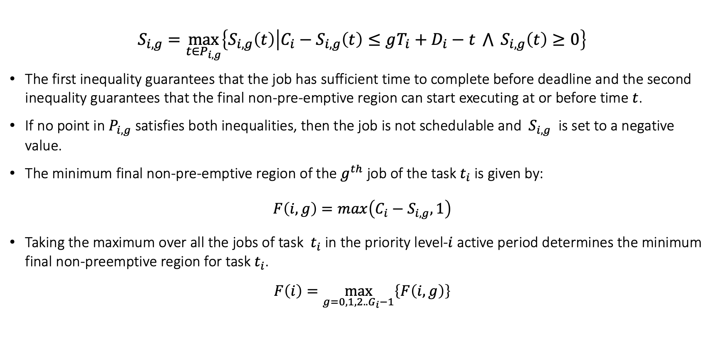
FNR Length Calculation
$$S_{i,g}=\max_{t∈P_{i,g}}\left\{S_{i,g}\left(t\right) | C_{i}−S_{i,g}\left(t\right)≤gT_{i}+D_{i}−t \bigwedge{ S_{i,g}\left(t\right)}≥0\right\}$$
The first inequality guarantees that the job has sufficient time to complete before deadline and the second inequality guarantees that the final non-pre-emptive region can start executing at or before time $t$.
If no point in $P_{i,g}$satisfies both inequalities, then the job is not schedulable and $S_{i,g}$ is set to a negative value.
The minimum final non-pre-emptive region of the $g^{th}$ job of the task $t_{i}$ is given by:
$$F\left(i,g\right)=max\left(C_{i}−S_{i,g},1\right)$$
Taking the maximum over all the jobs of task $t_{i}$ in the priority level-$i$ active period determines the minimum final non-preemptive region for task $t_{i}$.
$$F\left(i\right)=\max_{g=0,1,2..G_{i}−1}\left\{F\left(i,g\right)\right\}$$

Slide 32
Experimental Evaluations

Slide 33
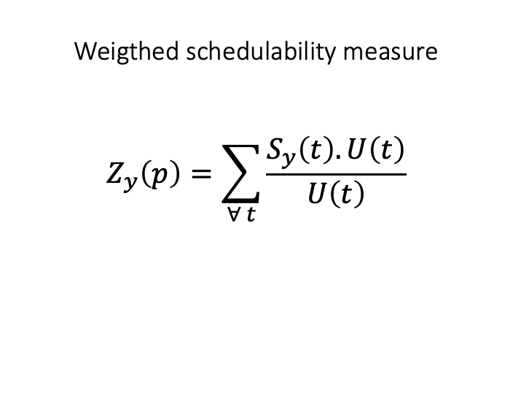
Experimental Evaluations
Weigthed schedulability measure
$$Z_{y}\left(p\right)=\sum_{∀ t}{\frac{S_{y}\left(t\right).U\left(t\right)}{U\left(t\right)}}$$

Slide 34
Back up

Slide 35
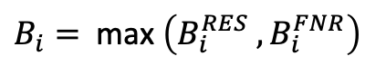
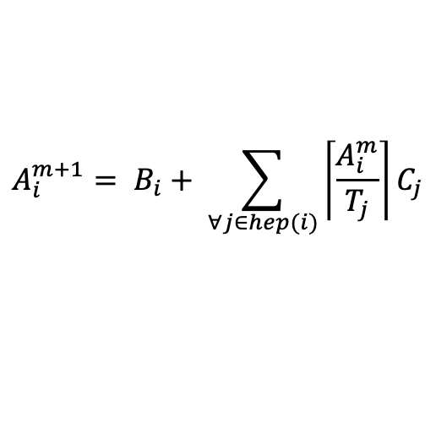
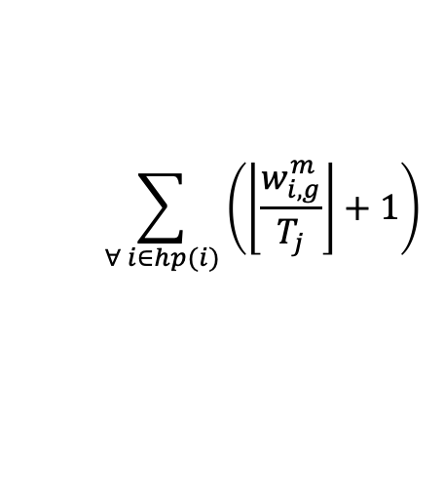
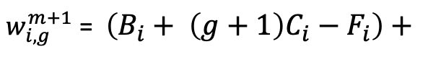
$$A_{i}^{m+1}= B_{i}+ \sum_{∀j∈hep(i)}{\left\lceil \frac{A_{i}^{m}}{T_{j}}\right\rceil C_{j}}$$
Worst case length of priority level-i active period
$B_{i}=$ max $\left(B_{i}^{RES} , B_{i}^{FNR}\right)$
$$\sum_{∀ i∈hp(i)}{\left(\left\lfloor \frac{w_{i,g}^{m}}{T_{j}}\right\rfloor +1\right)}$$
$w_{i,g}^{m+1}$ = $\left(B_{i}+ \left(g+1\right)C_{i}−F_{i}\right)+$
Start of priority level-i active period
$$R_{i}= \max\left(W_{i,g}^{NP}+ F_{i} −gT_{i}\right) \left(∀ g=0,1,2 …G_{i}−1\right)$$

